Slide 1
Utopia & Vegetarianism : A line of research Scuola Grande di San Marco
Fátima Vieira
Universidade do Porto
CETAPS Centre for English, Translation and Anglo-Portuguese Studies

Slide 2
Food Studies
“[It aims to go beyond] agricultural science, nutrition, culinary arts, and gastronomy in that it deals with more than the simple production, consumption, and aesthetic appreciation of food. It is the study of food and its relationship to the human experience.” (Almerico, 2014)

Slide 3
Food Studies
Multidisciplinary critical enquire
Identity issues
The caption of food voices (Hauck-Lawson)
Human beings do not simply feed, they spend energy, money and creativity in preparing food, and they are the only living species that shares food (Gina Almerico).

Slide 4
Food Studies & Utopian Studies
Imagination of the food of the future
Food Futures: ethics, science and culture
European Society for Agriculture and Food Ethics
EurSAFE International Conference
University of Porto, 29th September – 1st October 2016

Slide 5
Utopian thinking
1) It sets goals (utopian on the horizon)
2) It implies awareness of the fact that societies work as systems
3) It forces us to devise alternative forms of organization

Slide 6
Food Studies & Utopian Studies
What may Food Studies bring to Utopian Studies?
to uncover hidden meanings” by asking pertinent questions

Slide 7
Lyman Sargent
Much utopianism is concerned with the “big” questions of economic, political, and social systems and downplays such apparently ‘little’ questions as what people eat. But once one asks what people eat, questions arise about how the food is produced, how it is prepared and who prepares it, how it is served and who serves it, who cleans up after the meal, and what happens to the leftovers.

Slide 8
And these questions clearly imply such issues as the nature of families and communities, gender relations, rural/urban relations, the economics and mechanics of production, distribution, and consumption, and sanitation, and these issues also clearly relate to the political system and how decisions about these questions are made (Sargent 2015).

Slide 9
Food Studies & Utopian Studies
What may Utopian Studies bring to Food Studies?
It offers a holistic prospective critical approach to food issues
Redirects the concerns about food in the present to the imagination of future alternatives

Slide 10
It provides Food Studies with a generative methodology (Ruth Levitas)
it fosters a productive critique
It challenges one’s capacity to think of what might be possible
It is a tool for construction that entails cross-disciplinary thought.

Slide 11
Utopia & Vegetarianism
Vegetarianism
far more than just a diet
A case study:
The Portuguese Vegetarian Society
Established in Porto in 1911
O Vegetariano - 1909

Slide 12
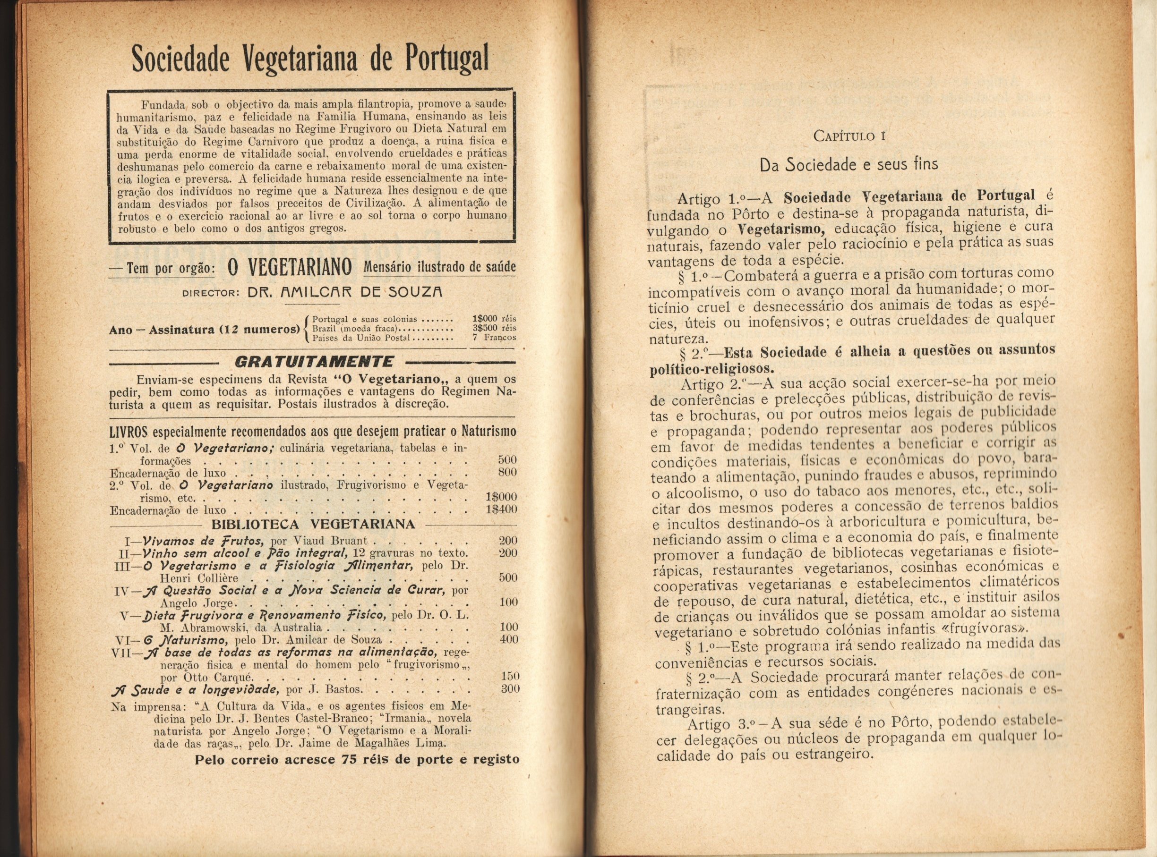

Slide 13
Portuguese Vegetarian Society
Motto:“Vegetarianism, Temperance and Morality”
Statutes:
“[the society is geared for providing popular instruction and civic education, by offering daytime and evening classes, in order to disseminate and popularise the principles of the vegetarian diet, suppressing the irrational slaughter of animals, favouring and praising abnegation out of the love for humanity, homeland, family, the Other, and charity towards the animals, combating alcoholism, smoking, vices and errors in general, and spreading temperance and moralising customs”.

Slide 14
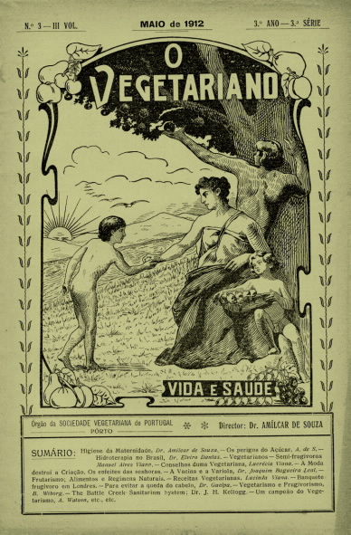
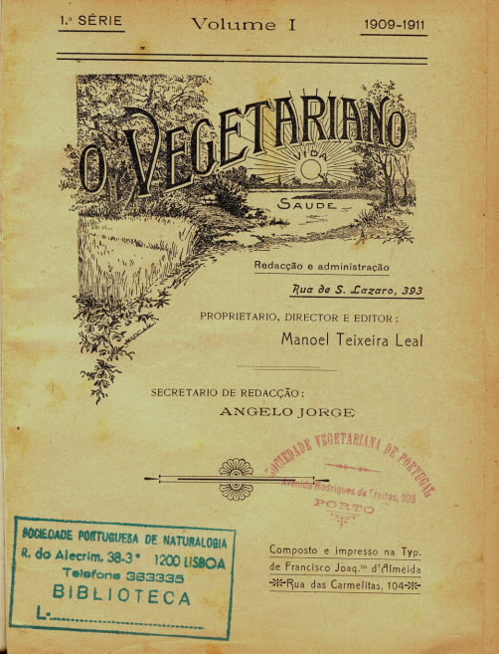

Slide 15
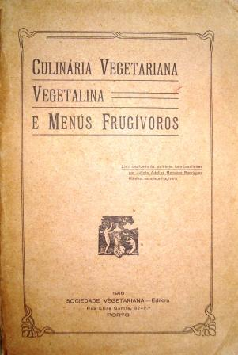

Slide 16
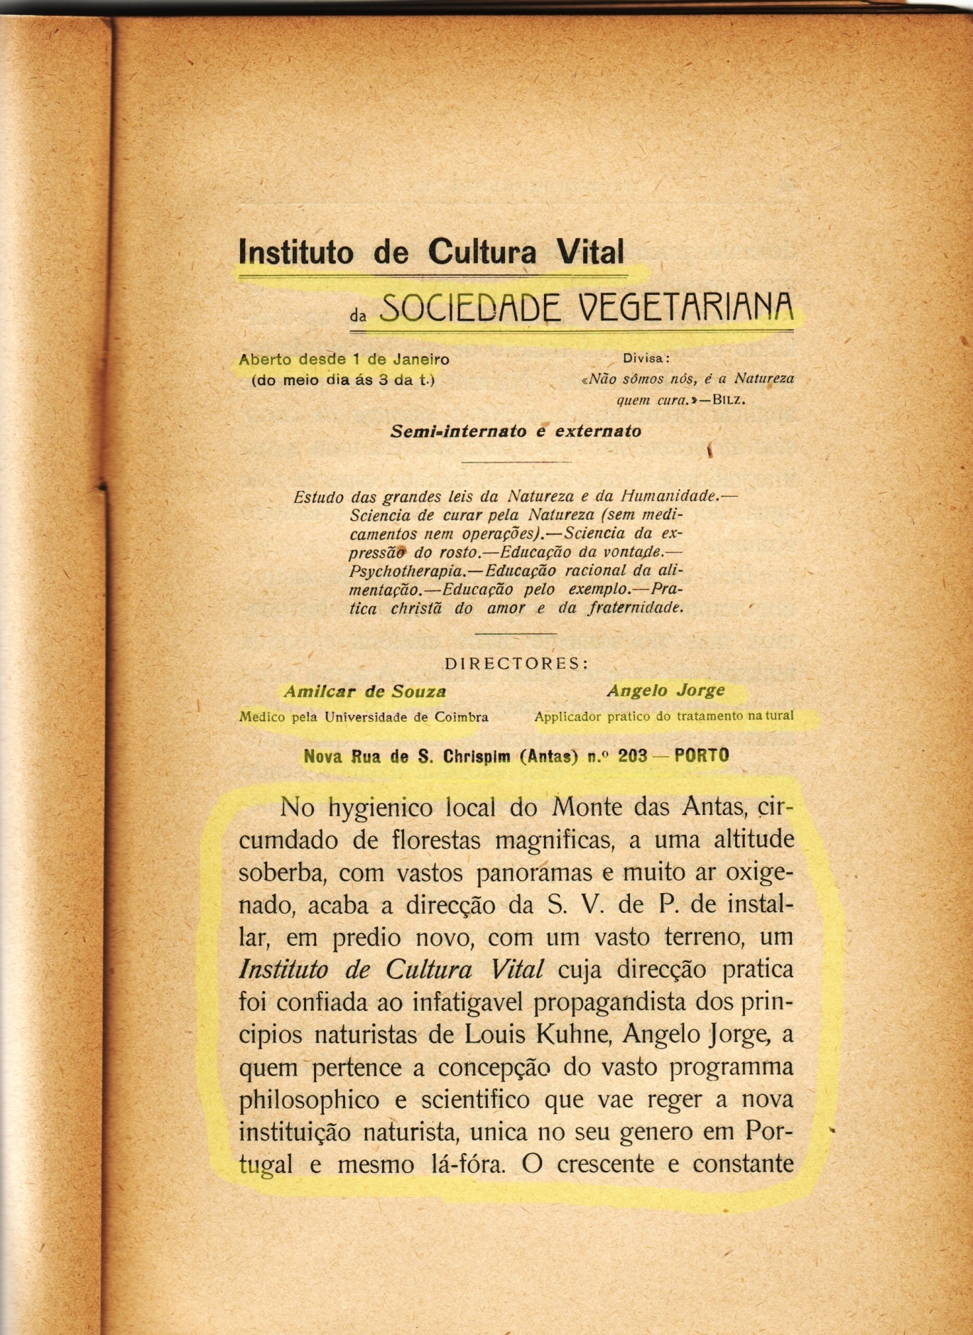

Slide 17
The founders and promoters
Ângelo Jorge (1883-1922)
Amílcar de Sousa (1876-1940)
Jaime de Magalhães Lima (1859-1936)

Slide 18

Ângelo Jorge
1912

Slide 19
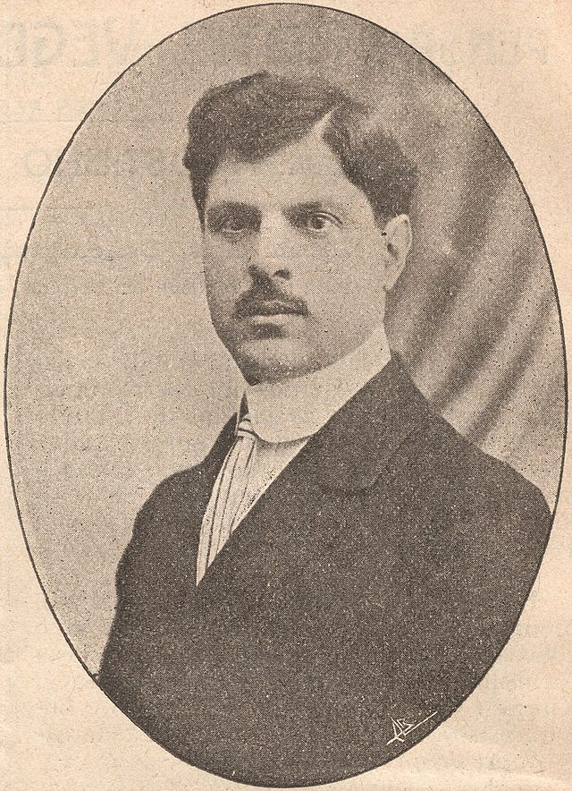

Amílcar de Sousa
1923

Slide 20
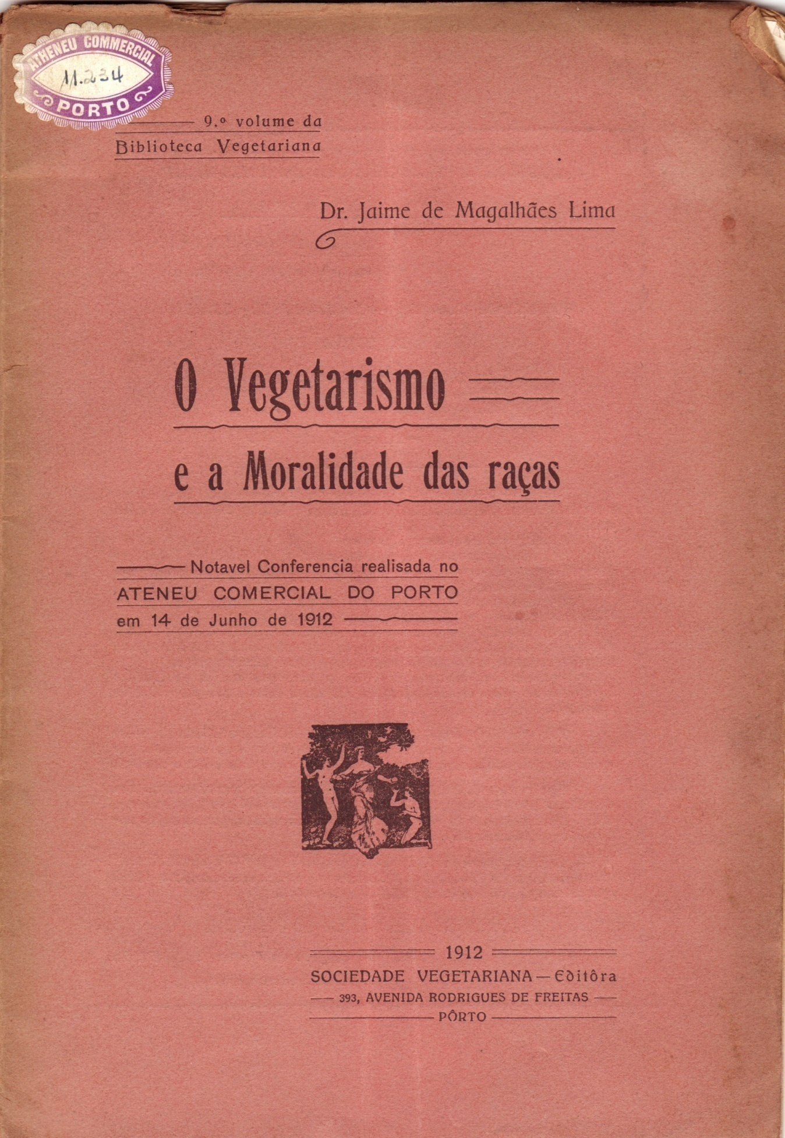
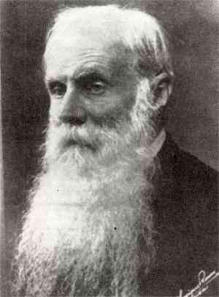
Jaime de Magalhães Lima
1912

Slide 21
The transformative power of vegetarianism
solution for the problems of
Famine
War
Poor hygiene and public health
(vegetarianism = moral attitude; a philosophy of life; political intervention)

Slide 22
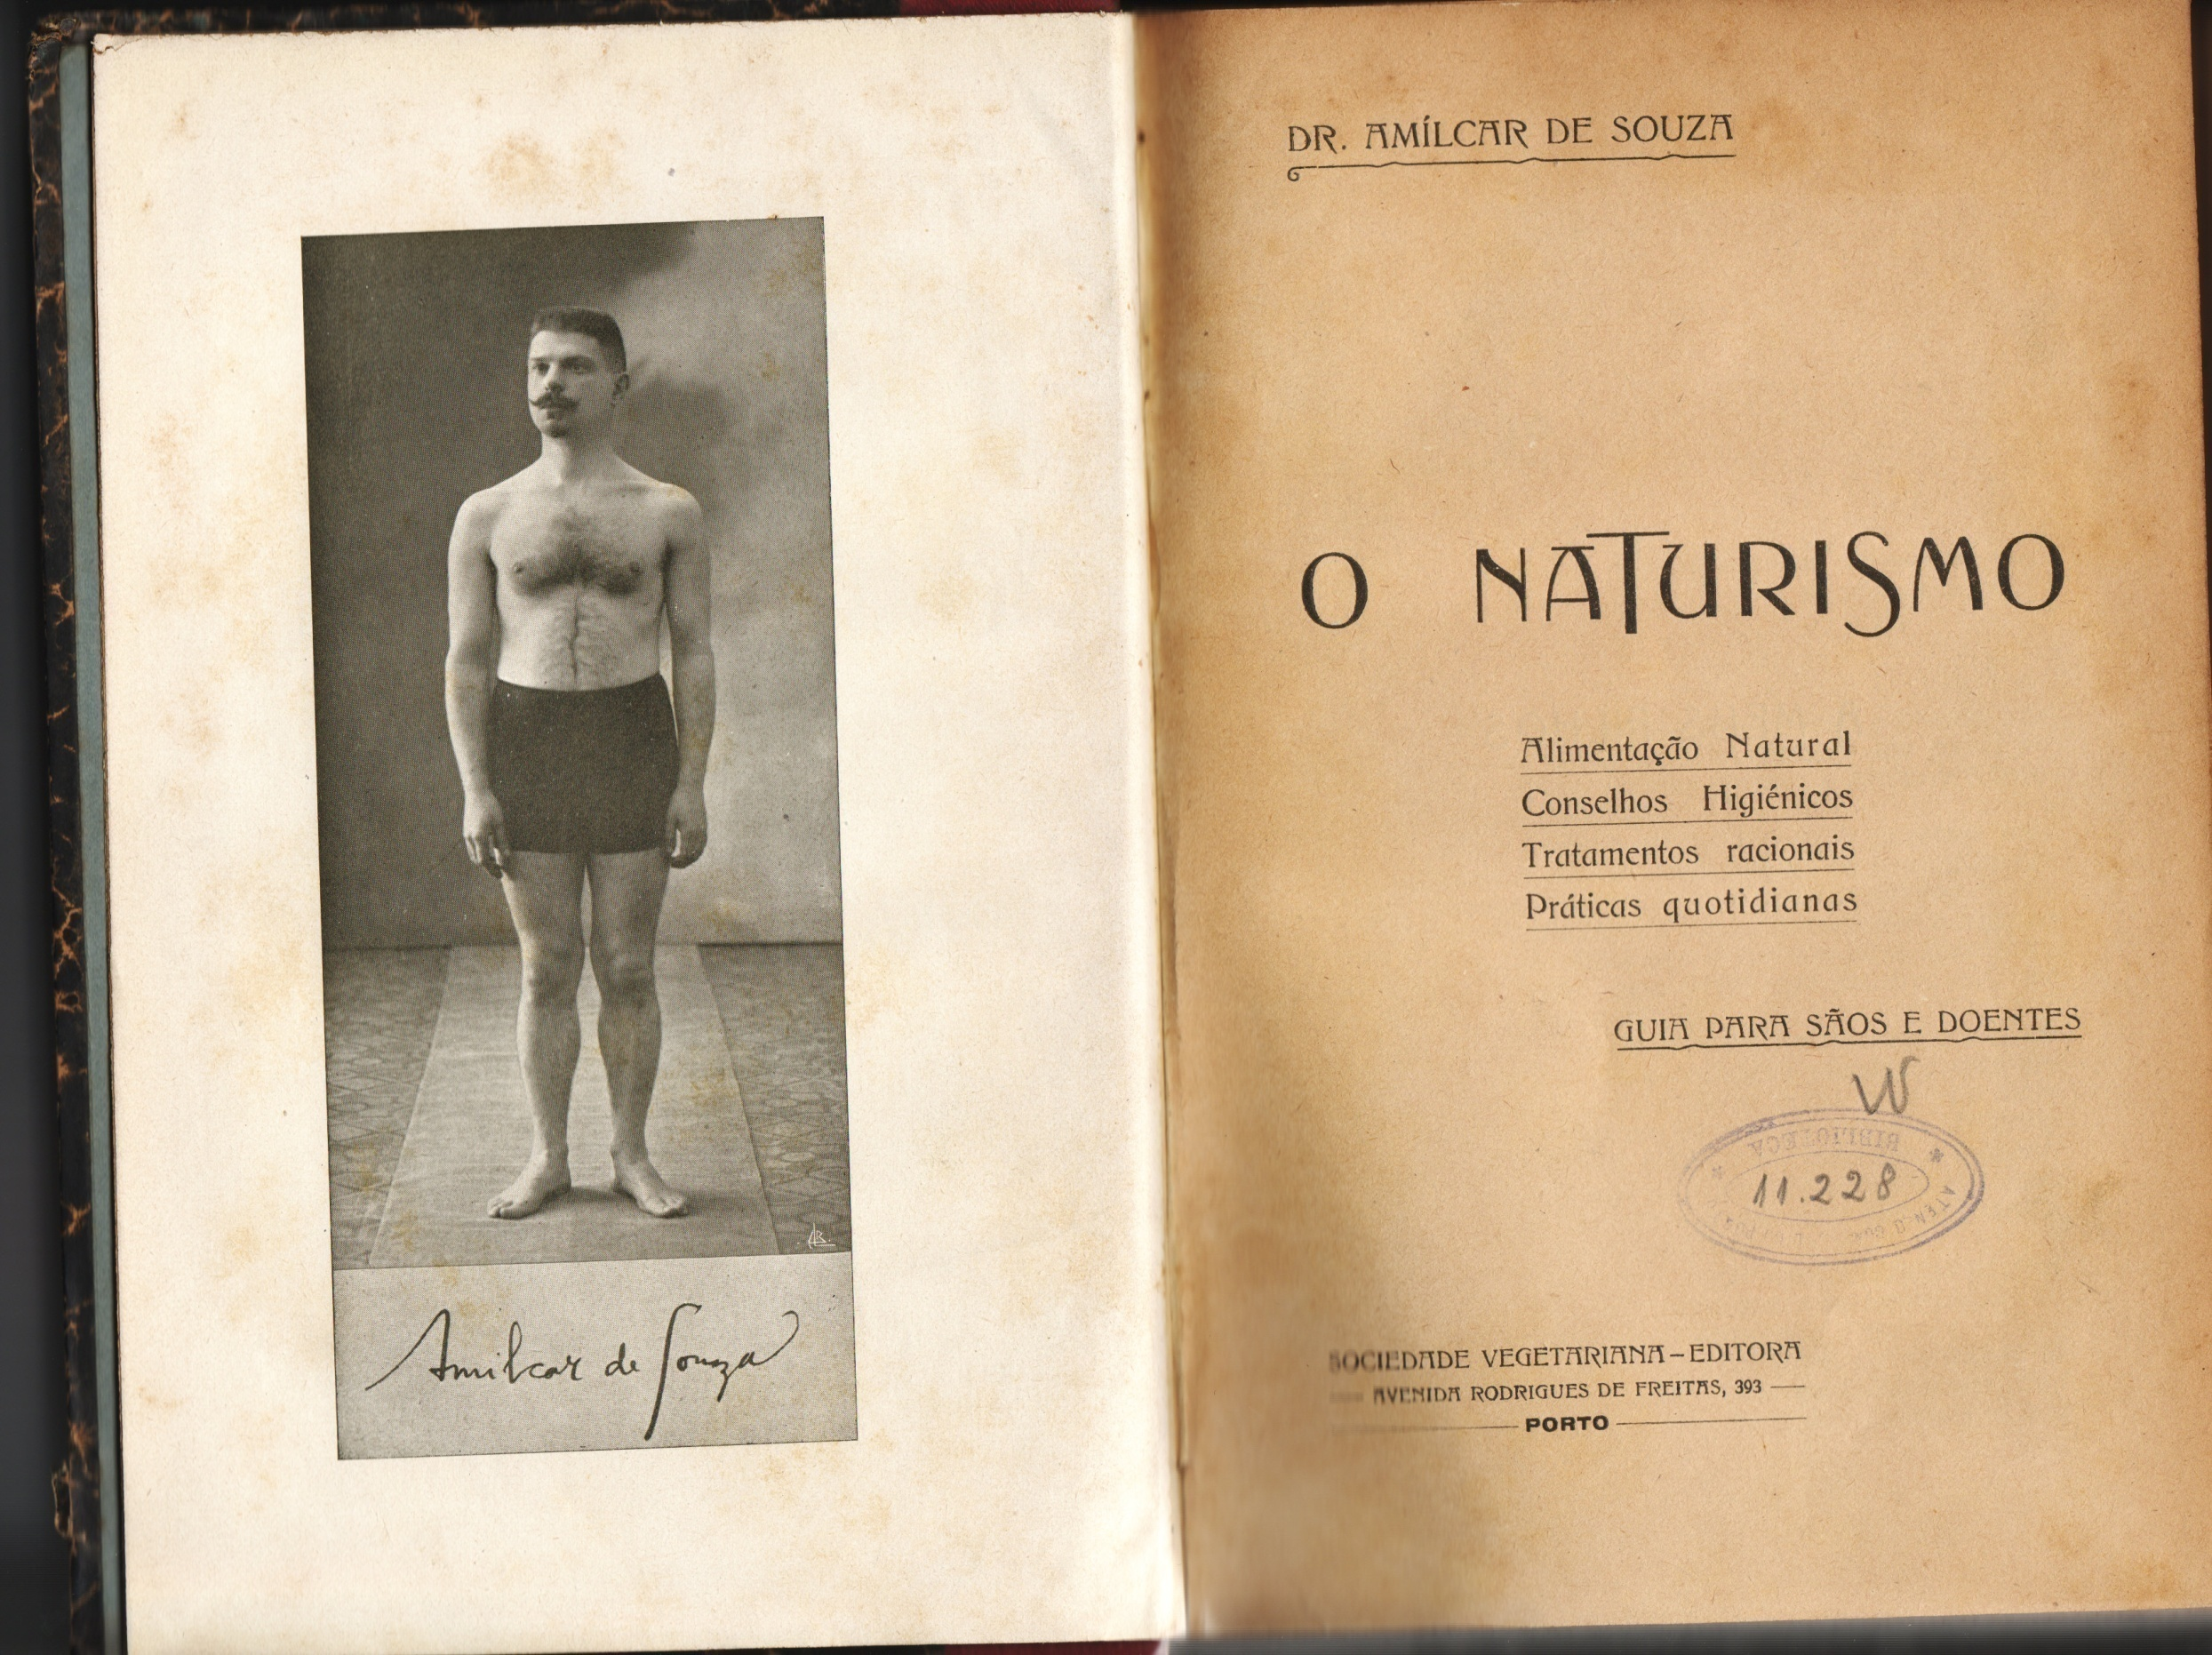

Slide 23
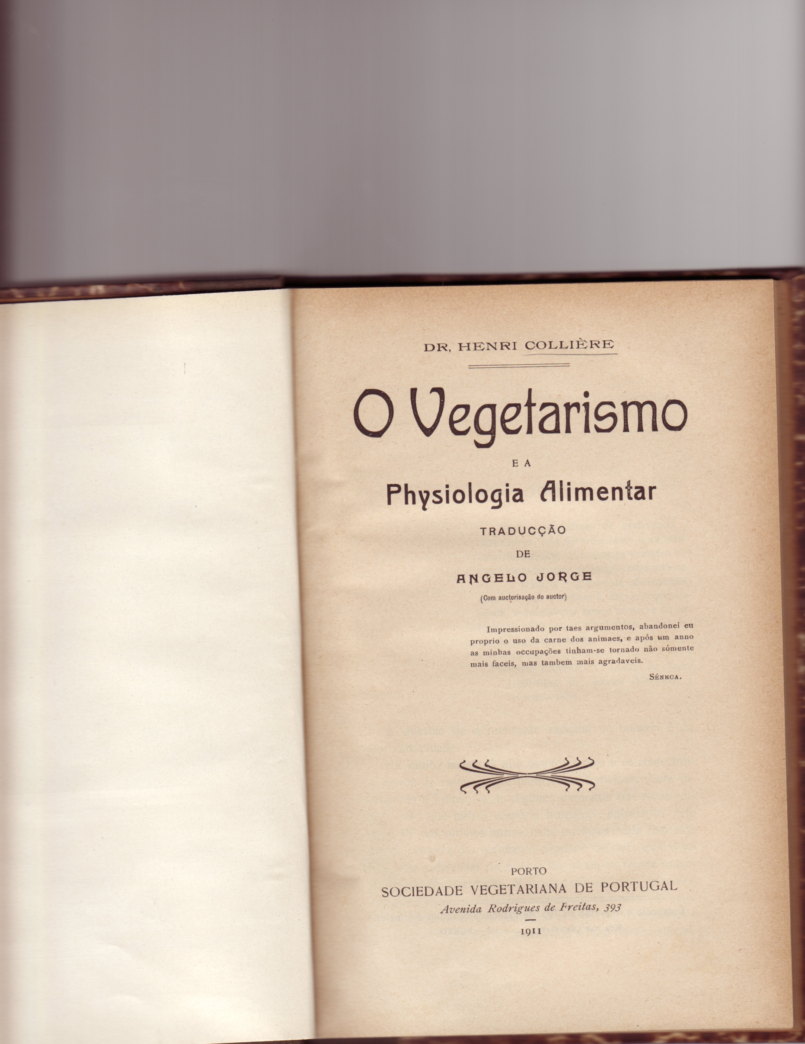

Slide 24
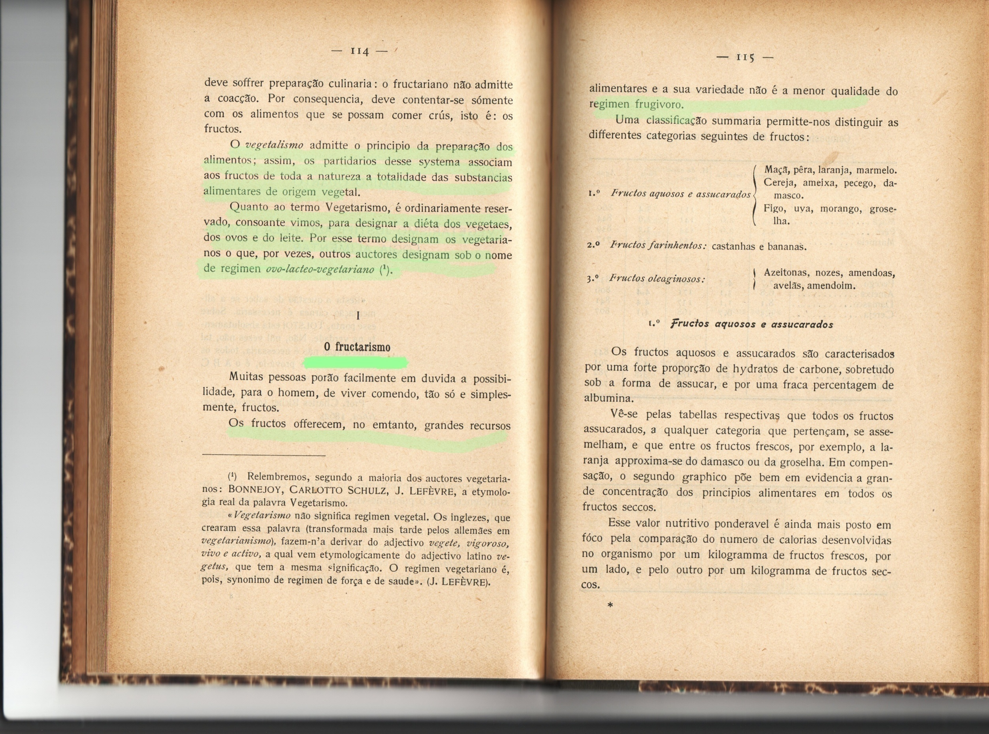

Slide 25
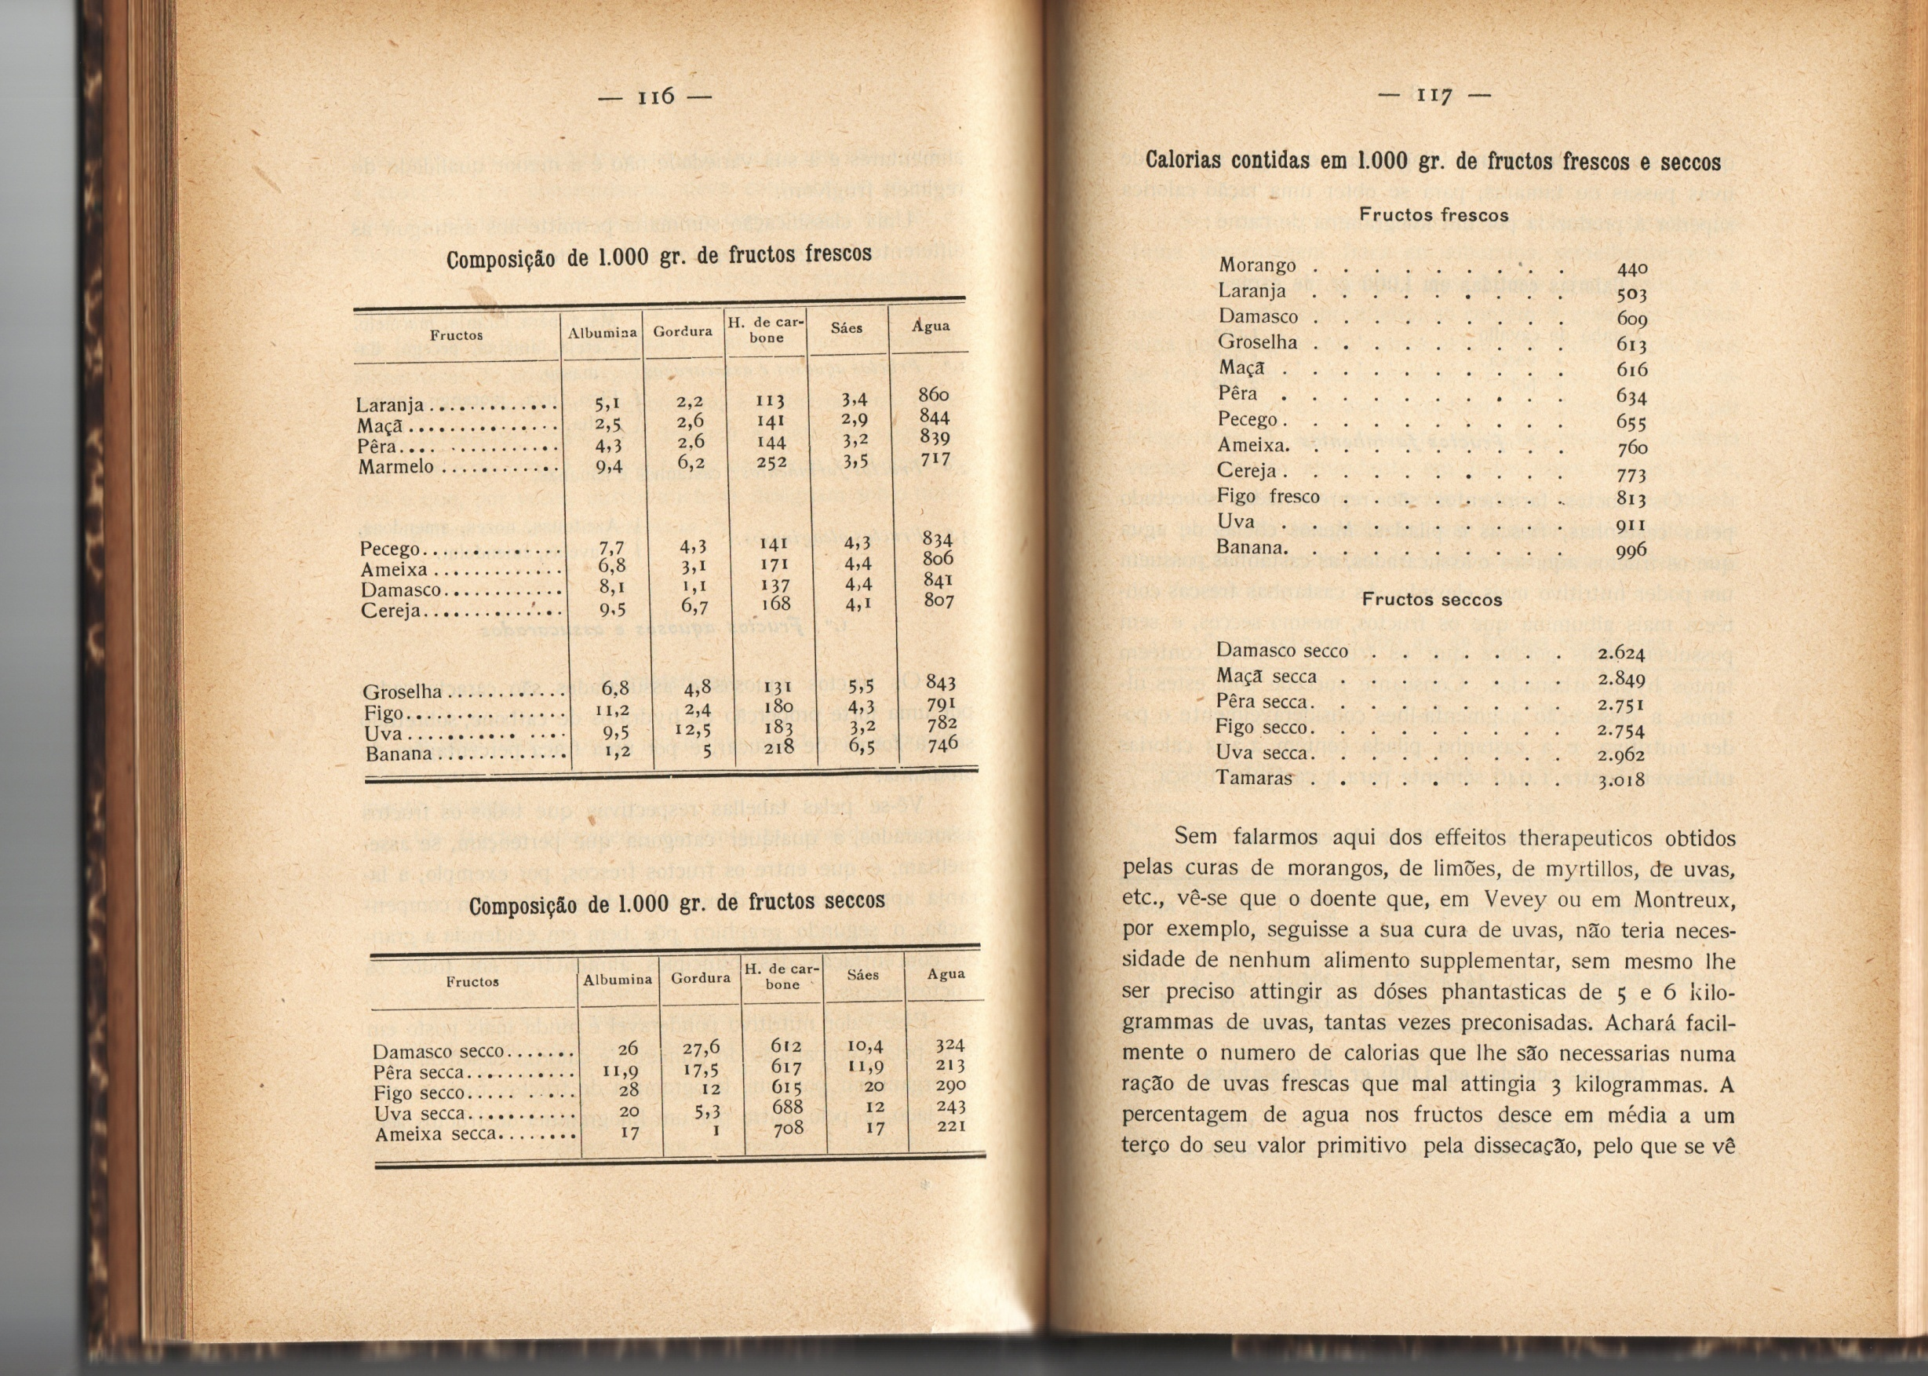

Slide 26
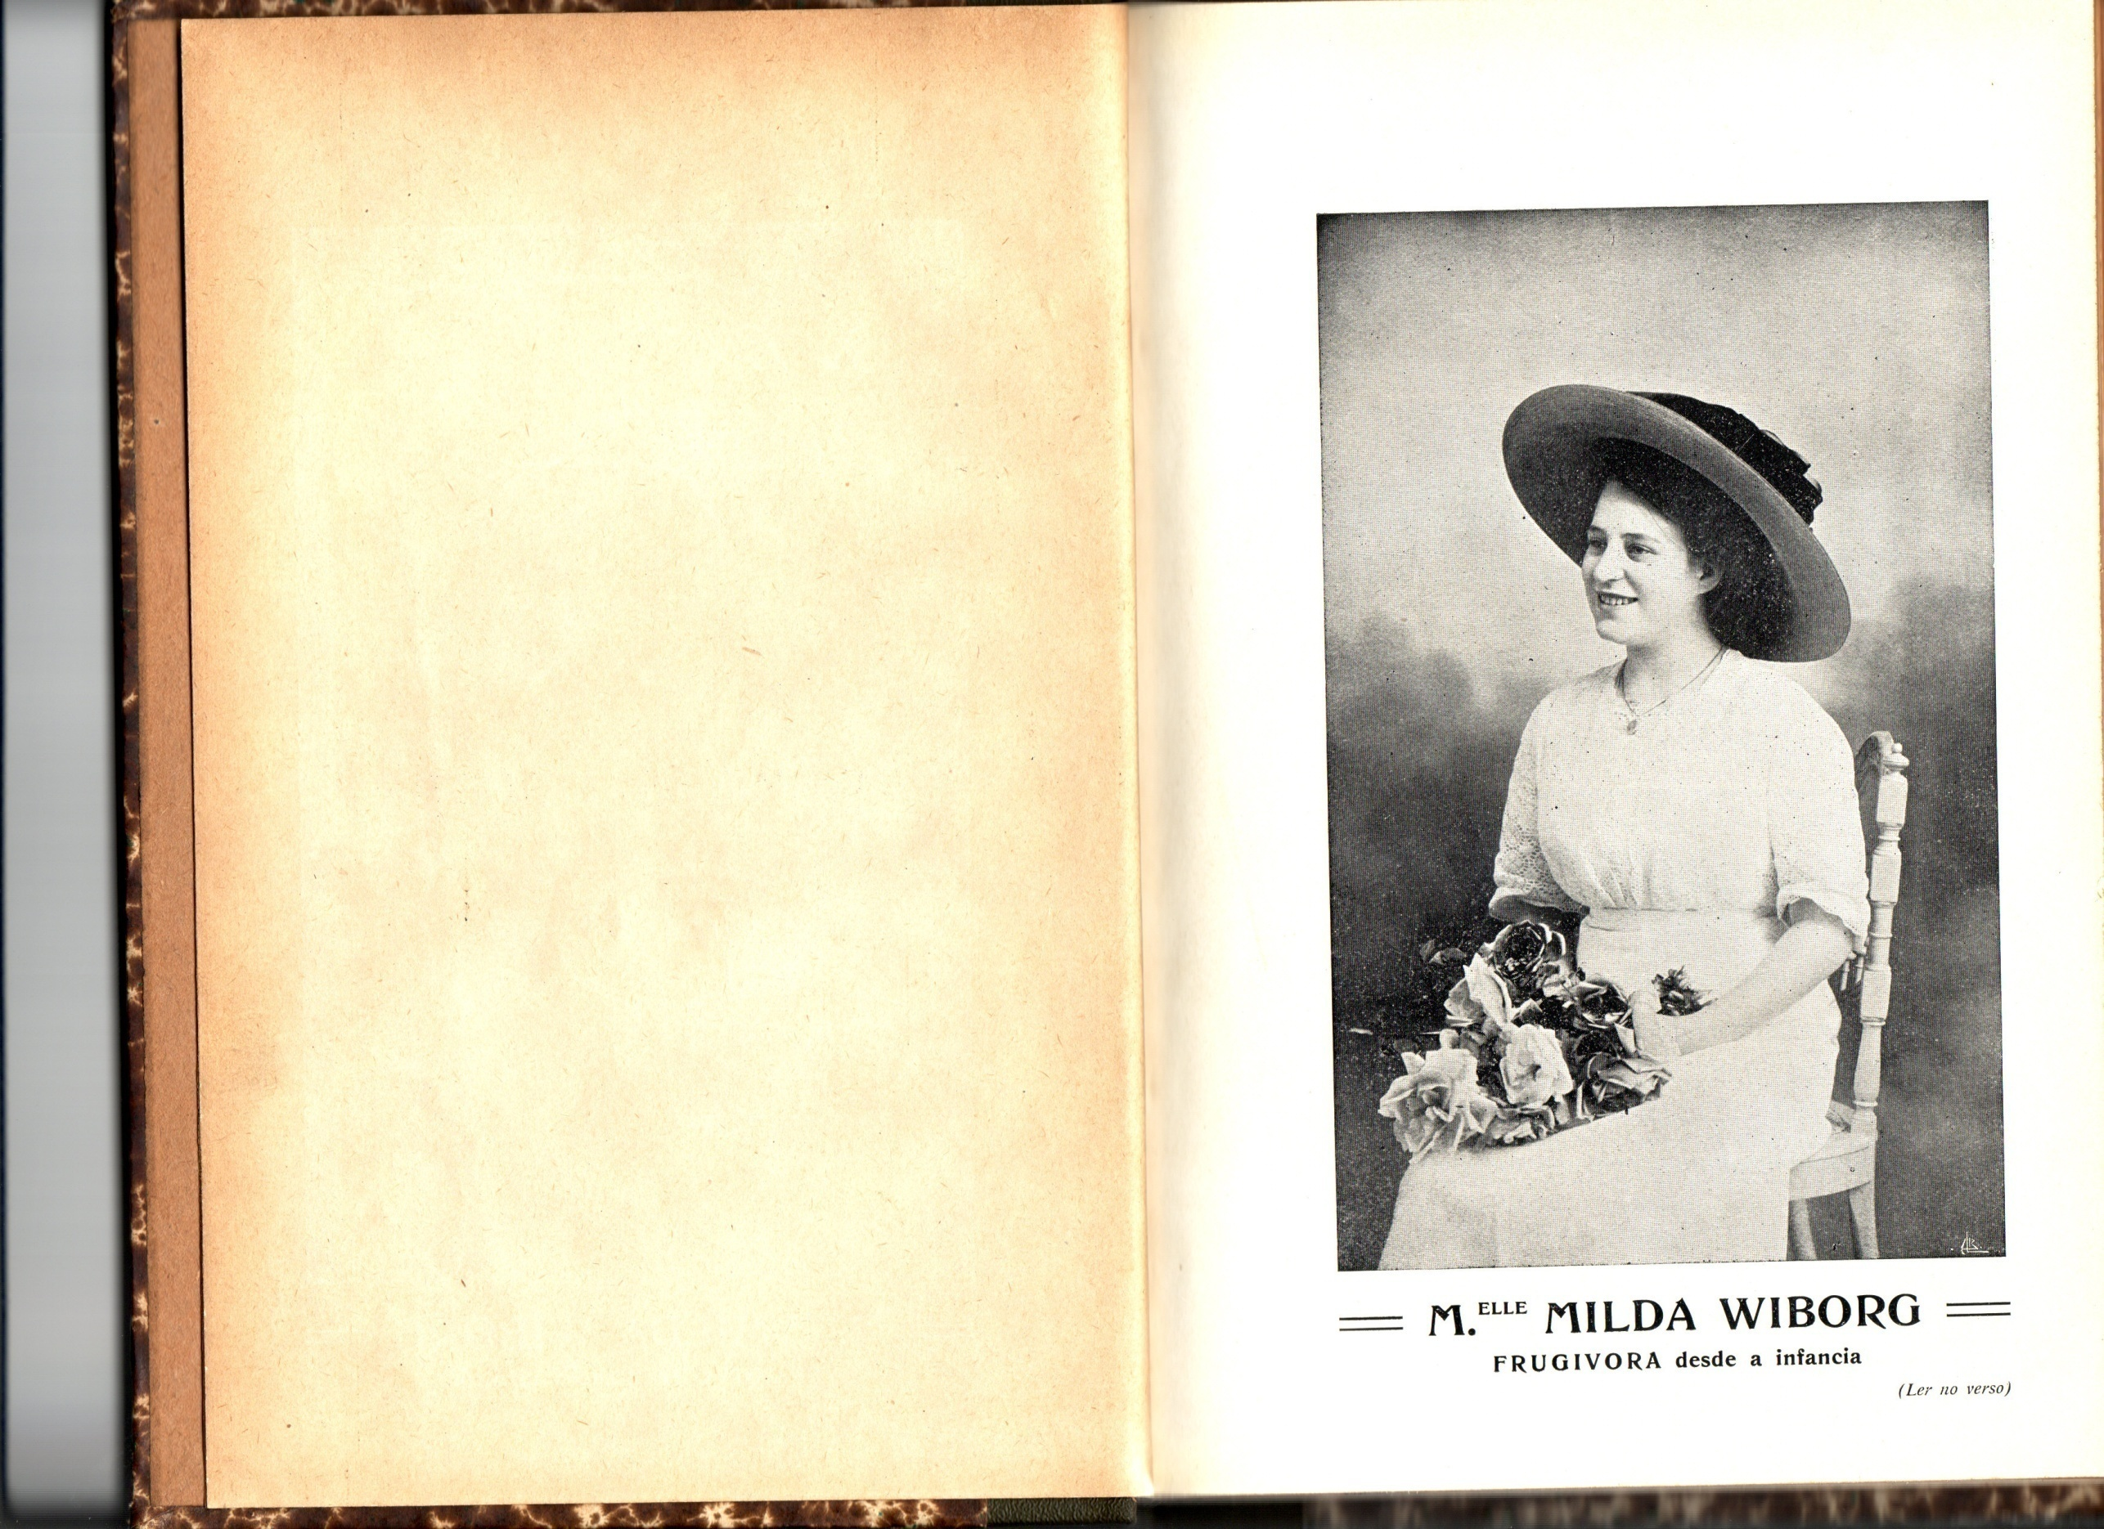

Slide 27
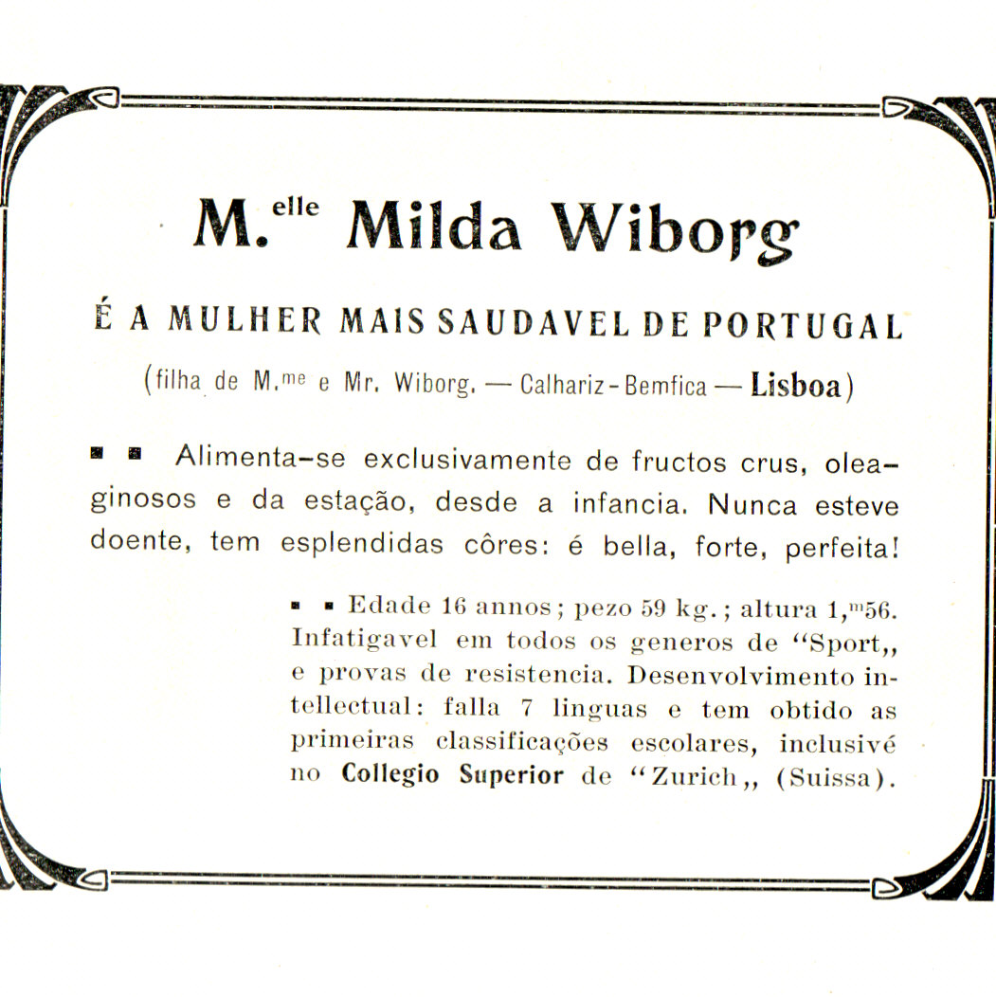

Slide 29
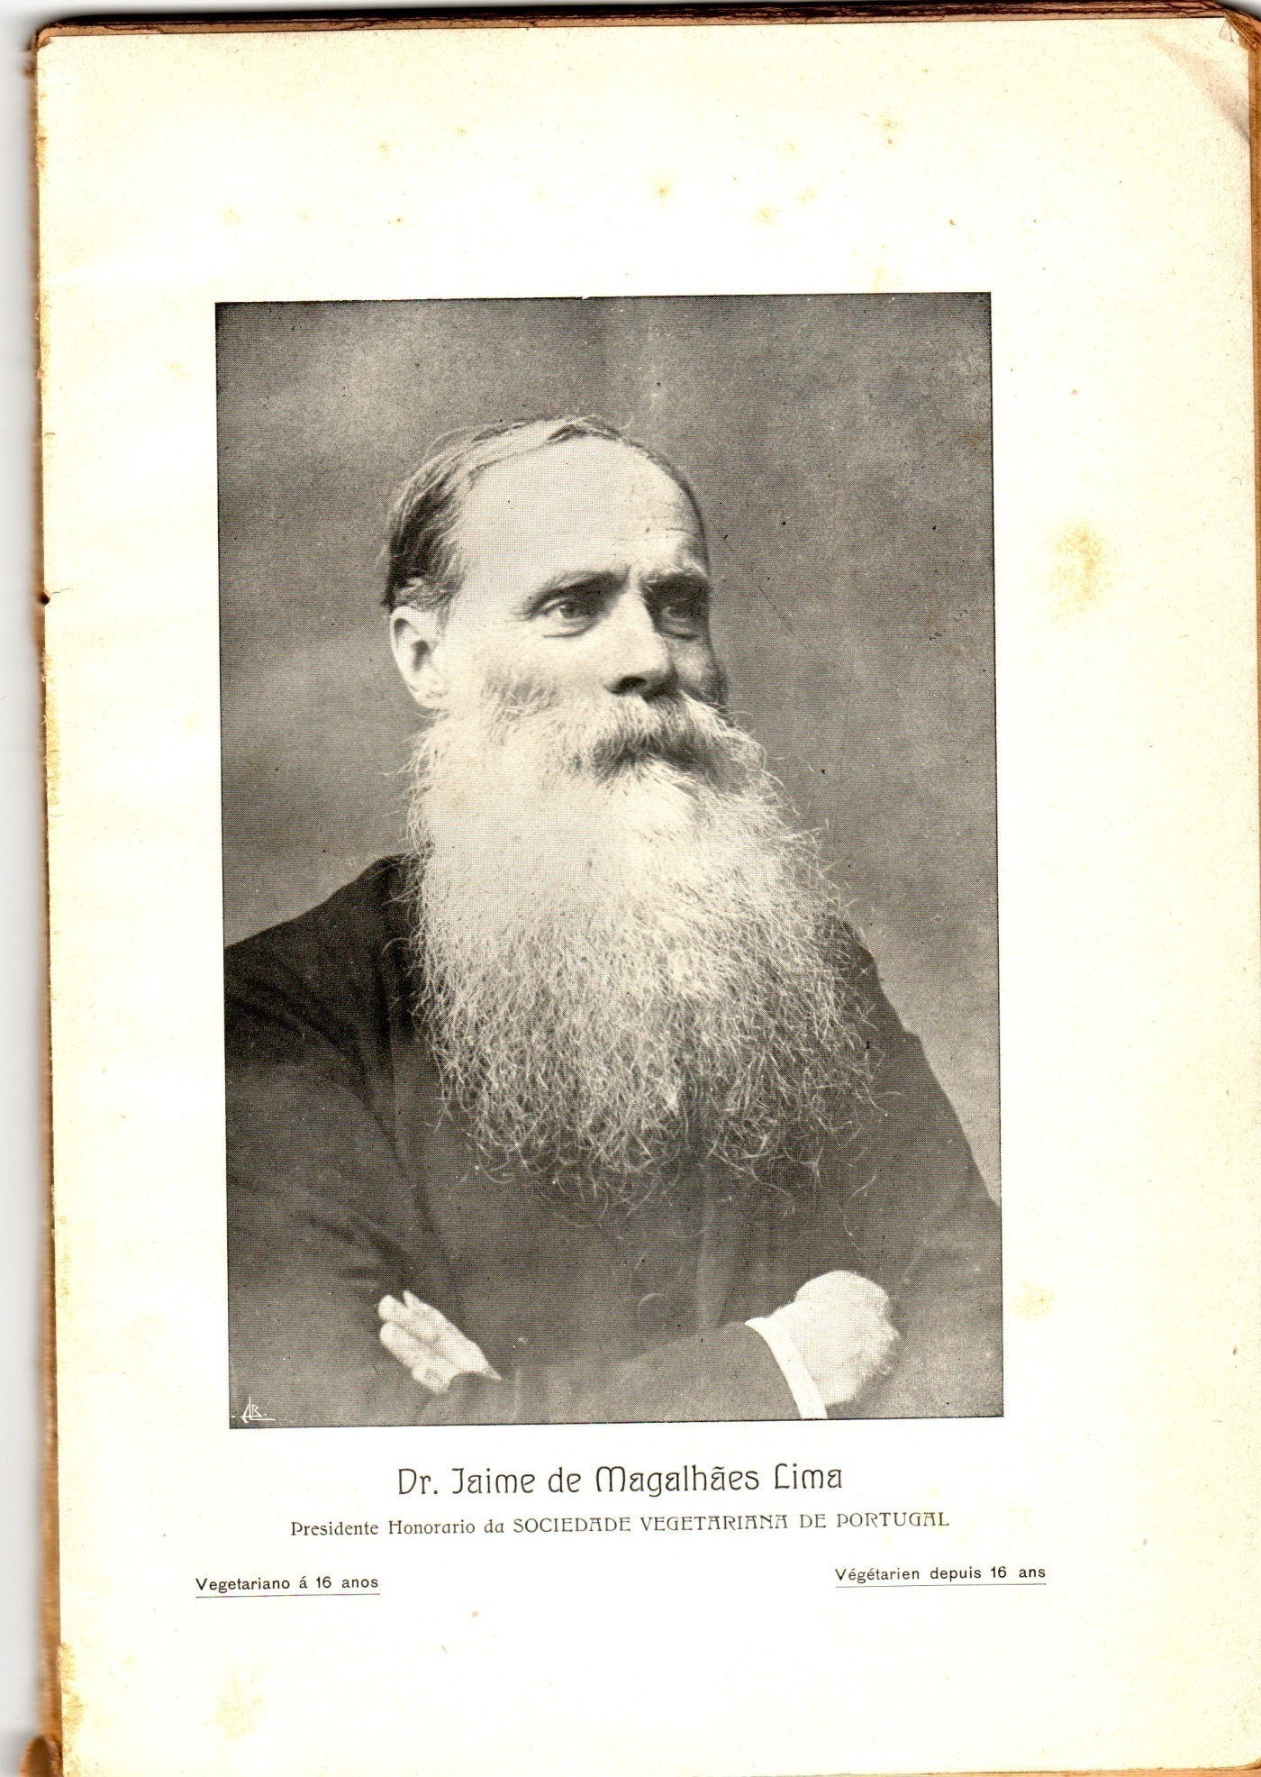

Slide 30
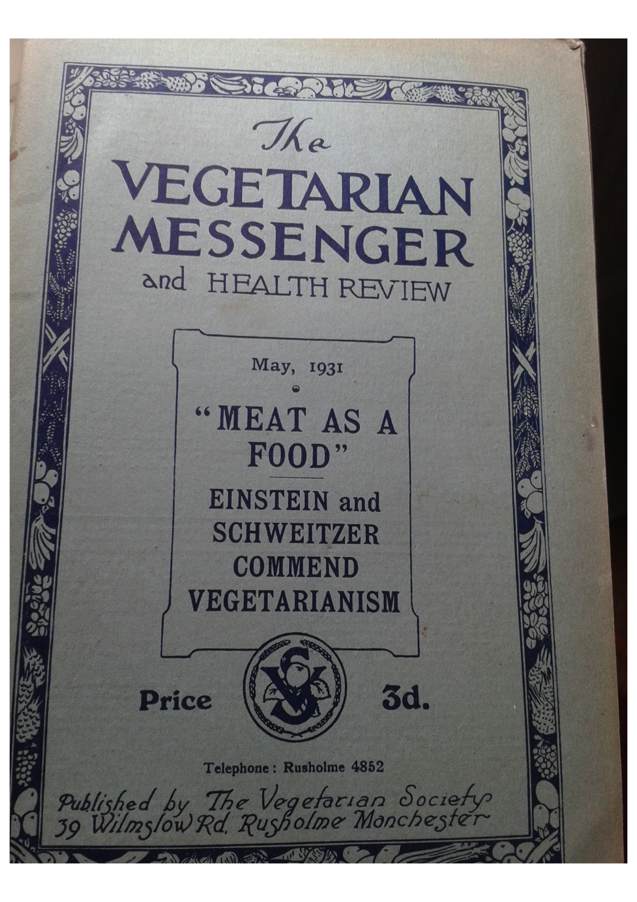

Slide 31
Jaime de Magalhães Lima
“Count Tolstoy pointed out many years ago that the adoption of a non-flesh diet was ‘The First Step’ towards the realization of peace and brotherhood among the nations of the earth (…) Man is virtually a semi-cannibal strewing his dinner table with the dismembered limbs of sentient creatures whose blood he sheds in order to satisfy a depraved taste. And so long as man acts in accordance with the law of the jungle so will he be incapable of recognizing the rights of his fellow-men. (…) The implications of flesh-eating are deep-rooted and affect practically all our social problems (in The Doctrines of Count Leo Tolstoy ,p. 95).”

Slide 32
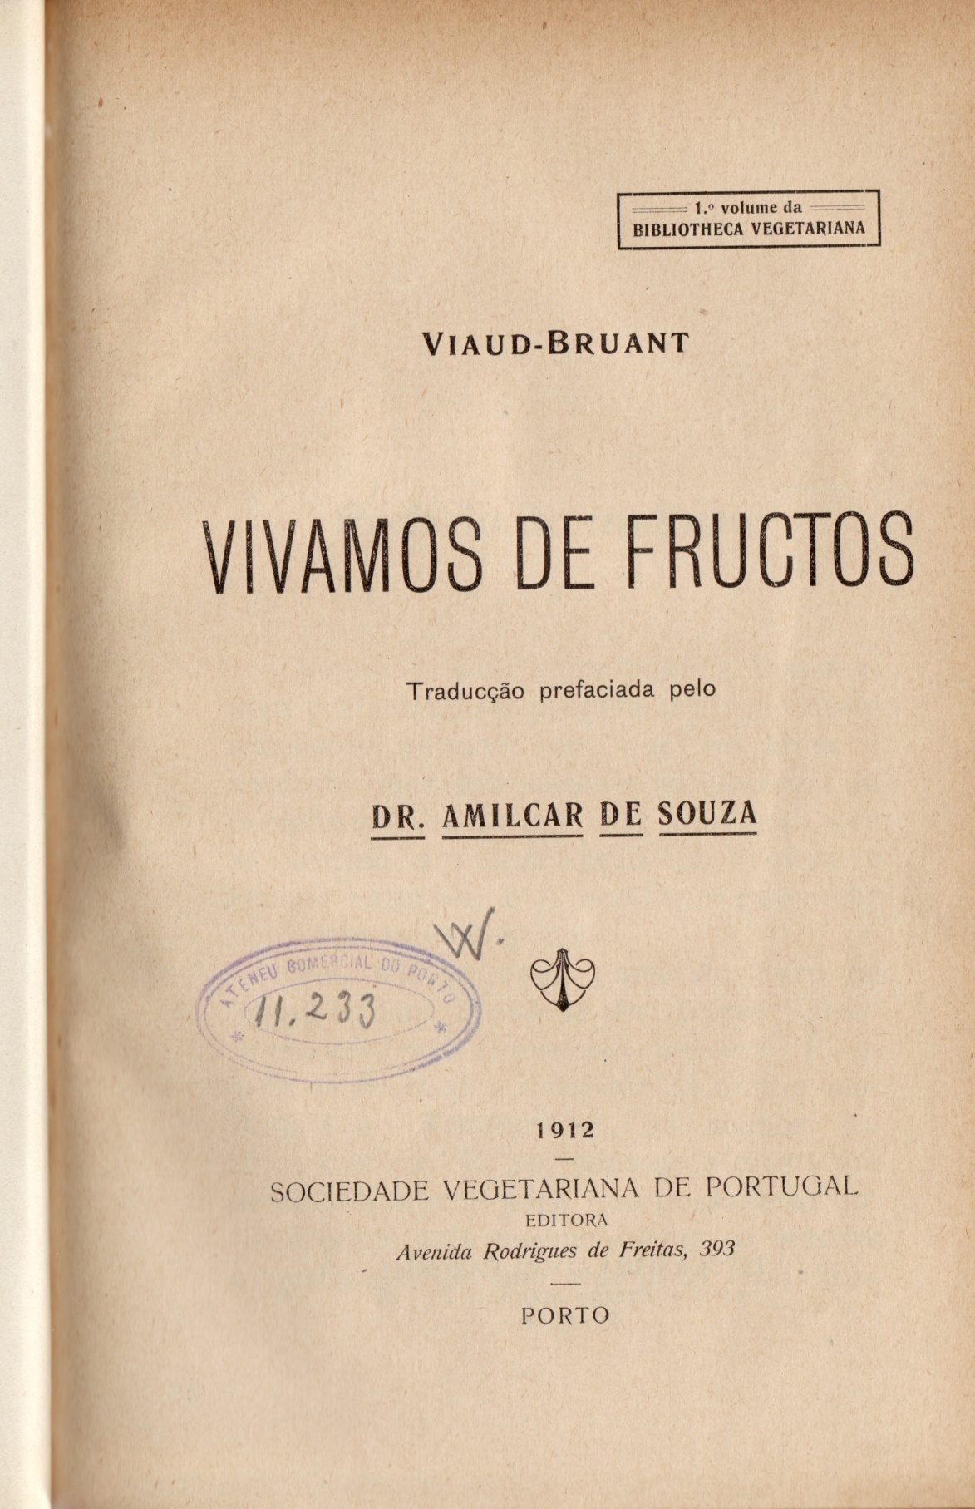

Slide 33
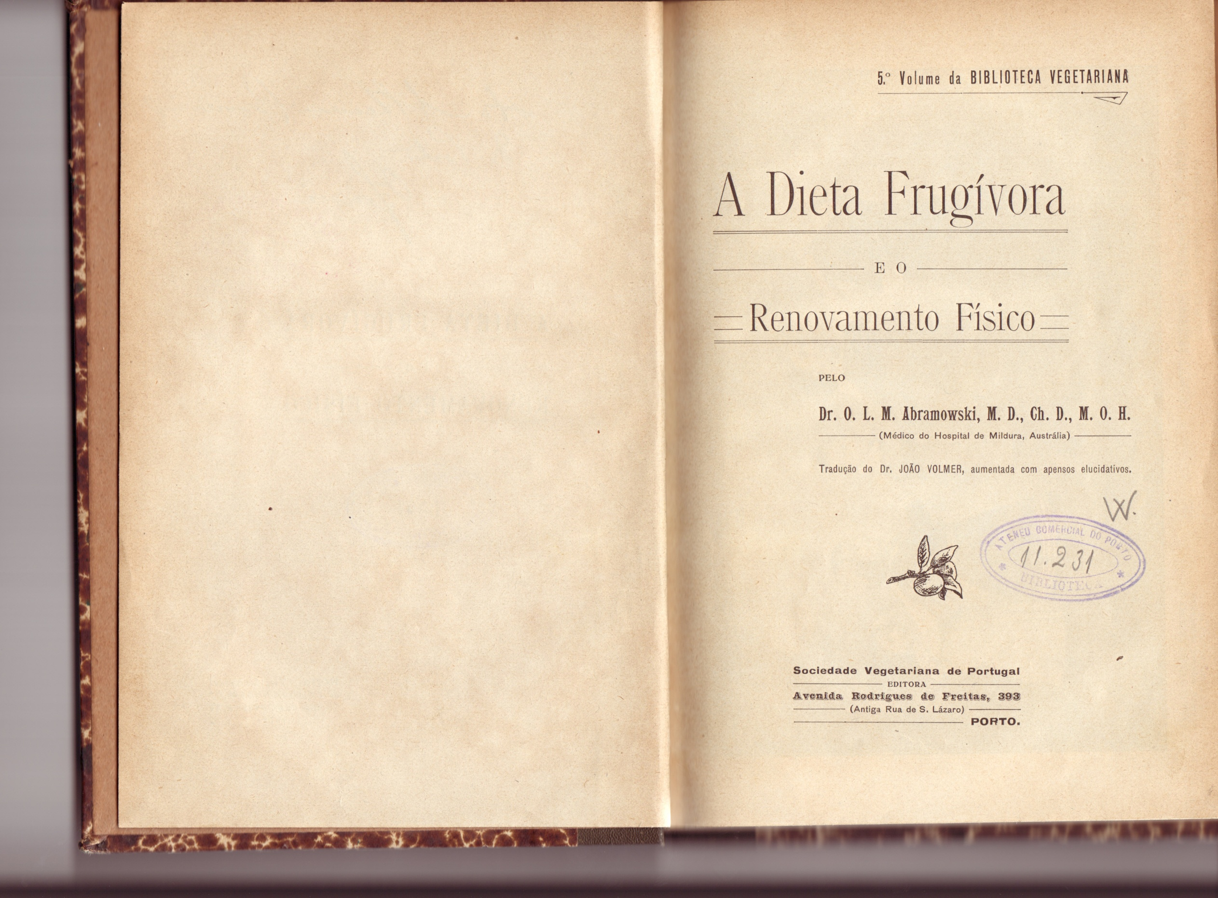

Slide 34
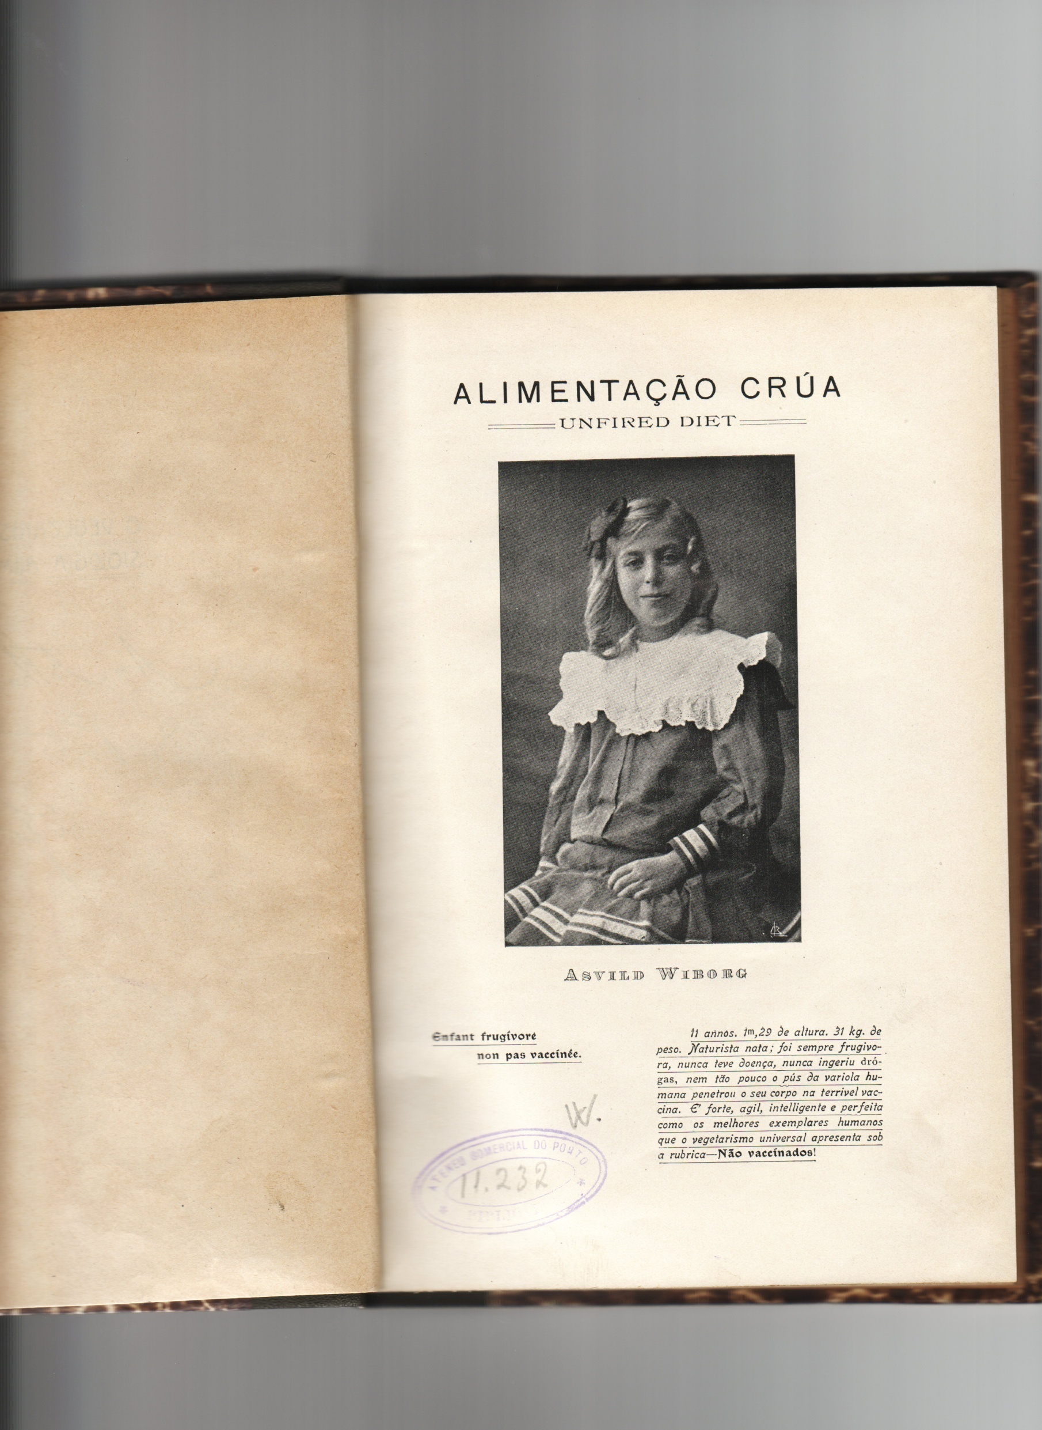

Slide 35
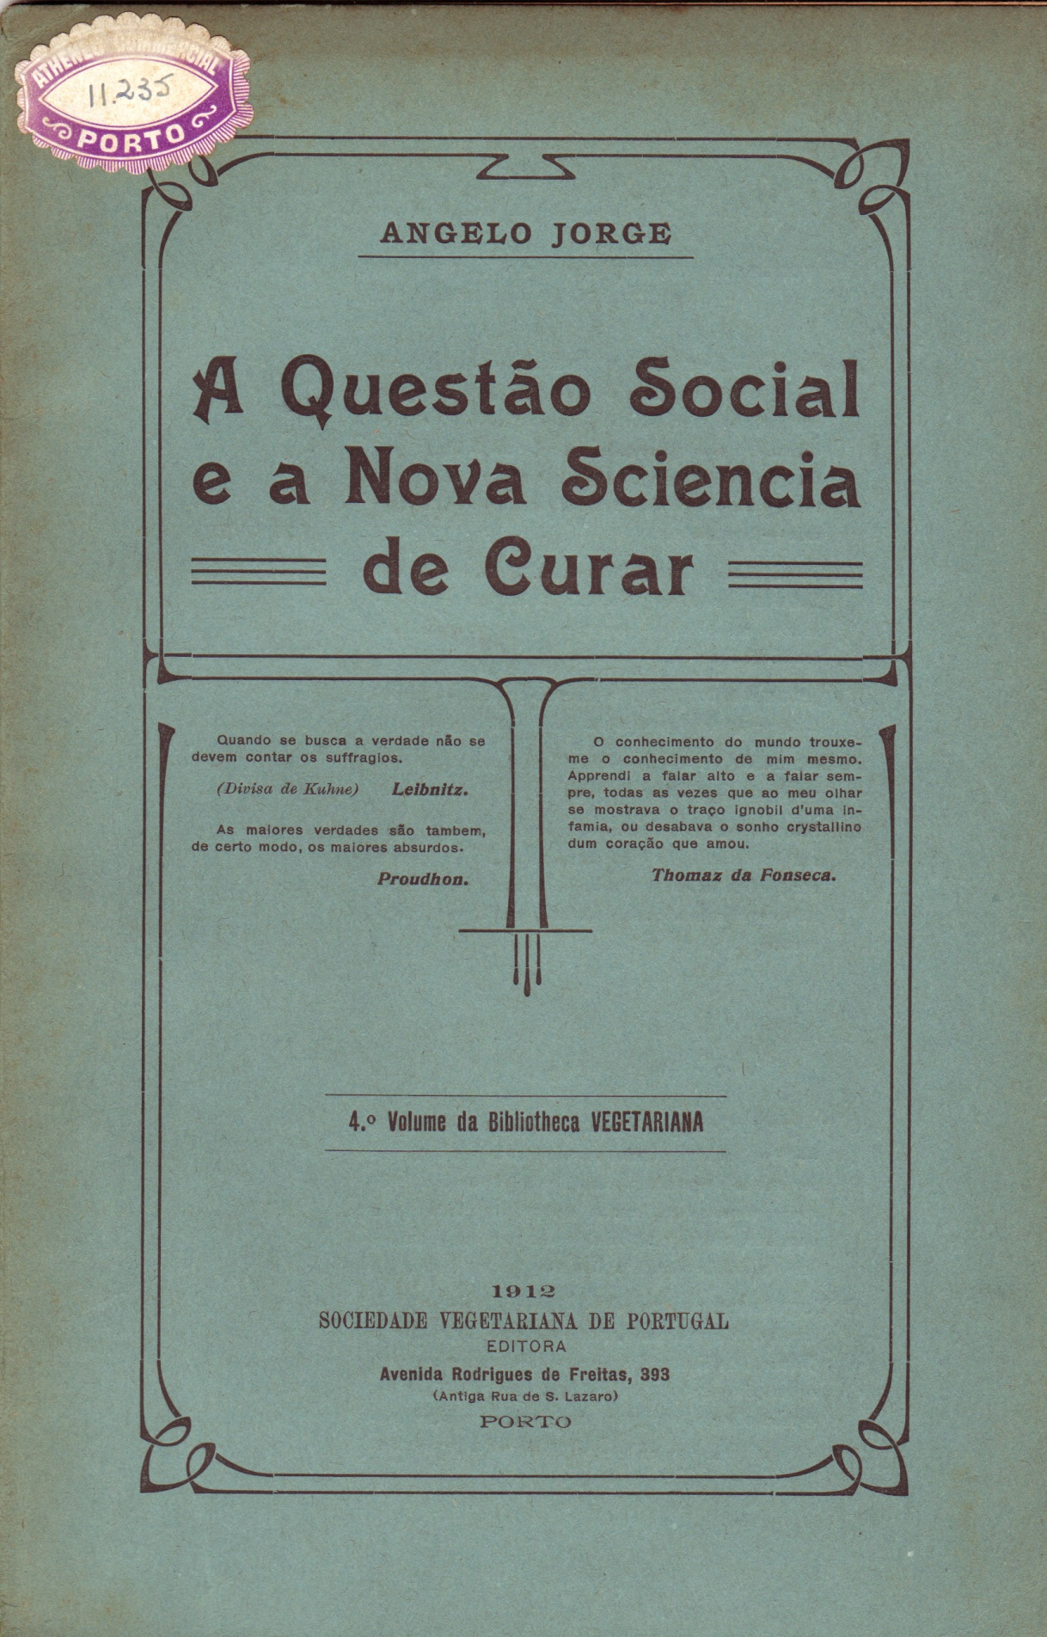

Slide 36
Ângelo Jorge
“There is one illness only in the human body – he says: Infraction of Natural law. The only way of healing is by obeying nature’s laws and forgetting the lies that have been invented by the medical sciences. Medical Sciences are “illogical”, as they expect to heal by poisoning the body”.
“[the vegetarian diet he recommends would transform] this rickety, deformed, clumsy race into healthy, beautiful and harmonious human beings”.

Slide 37
Ângelo Jorge, A Questão Social e a Nova Sciencia de Curar (1912)
Justification of vegetarianism
From a health perspective
From a moral perspective
From an economic perspective
From a cultural perspective
From an educational perspective
From the perspective of freedom

Slide 38
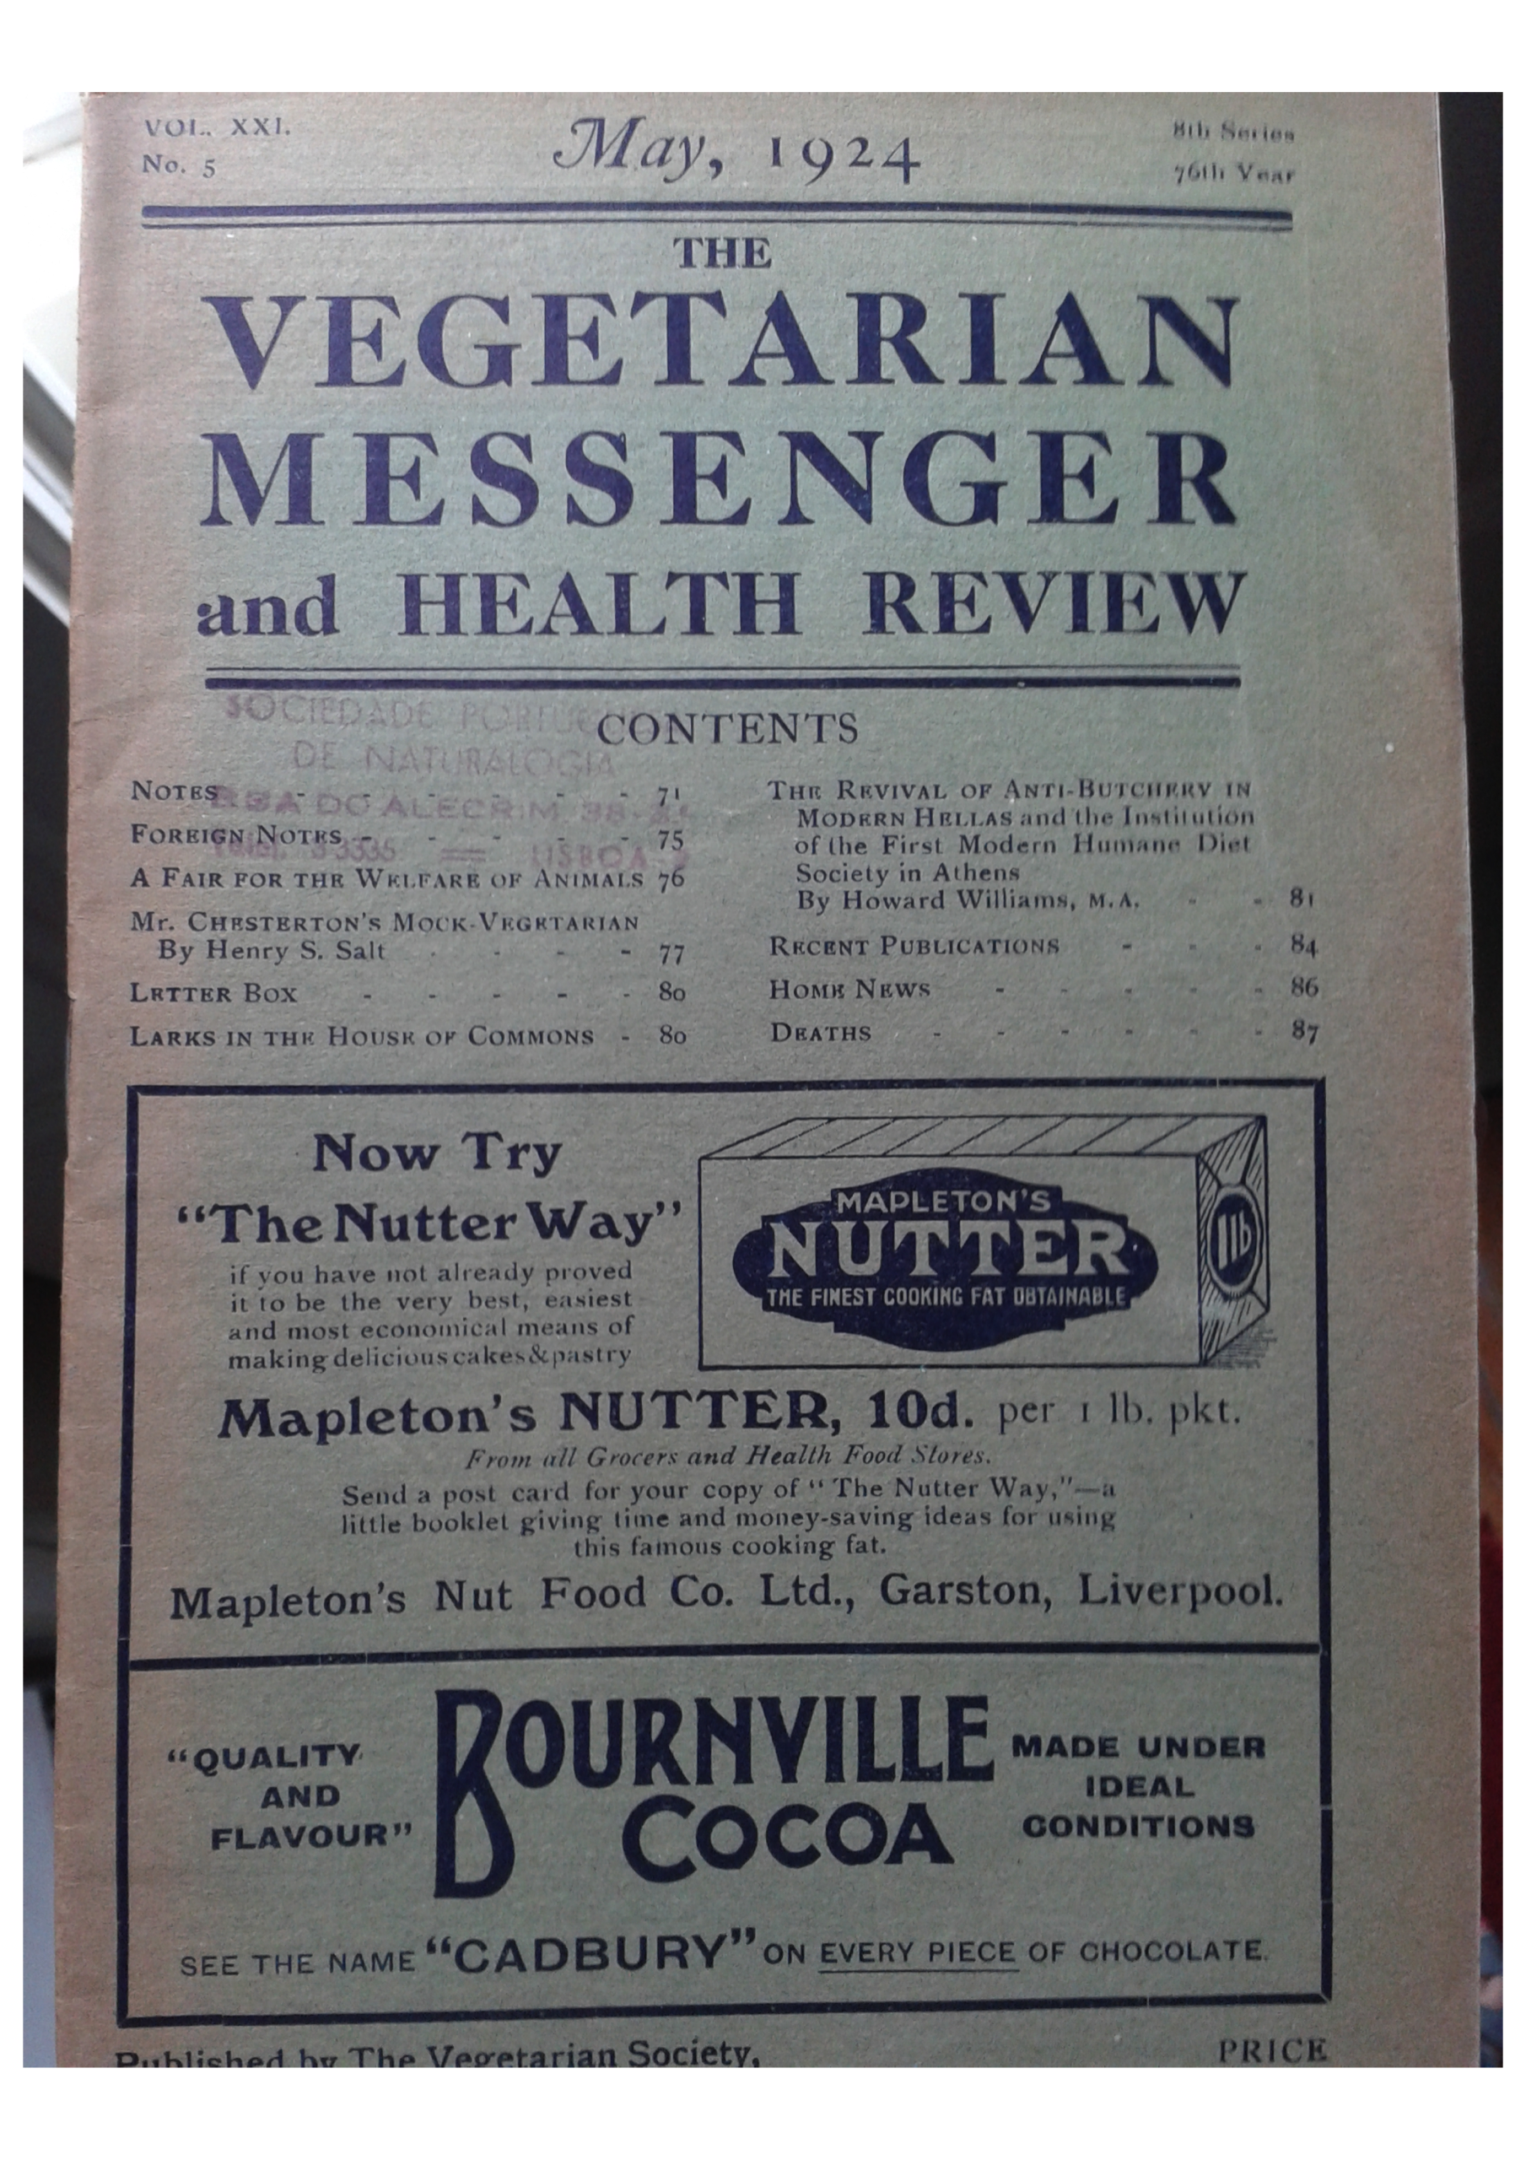

Slide 39
The Portuguese Vegetarian Society
Why did it die out in 1935?

Slide 40
Why did the movement die out?
1. Political reasons
Gonçalvez Correia, 1919:
“Naturism and Anarchism form a sacred alliance”
Manuel Rodrigues, 1924
“the naturist struggle (…) precedes the struggle for the social fulfilment of Anarchism”
Jaime de Magalhães Lima
A “Catholic Anarchist”
Amílcar de Souza
A libertarian

Slide 41
2. Health reason
Radical vegetarianism
Fruitarianism

Slide 42
3. A moment, not a movement
Collective identity

Slide 43
Why is Vegetarianism & Utopia an interesting line of research for Food Studies?
1) it requires a multidimensional approach;
2) it provides Food Studies with a productive set of critical research questions (the Utopian Studies questions)
3) It will benefit from IT advancements – contribution to the Digital Humanities

